Slide 1
Code Generation Unit 4 Compiler Design (14CS73)
Dr. Saroja Devi H.

Slide 2
Overview
Code generation is the final phase in the compiler
Takes as input IR code and produces semantically equivalent target program.
Main tasks:
Instruction selection,
Register allocation & assignment
Instruction ordering
Must : *preserve semantic meaning, *be of high quality * do effective use of the resources * run efficiently & fast * produce correct code

Slide 3
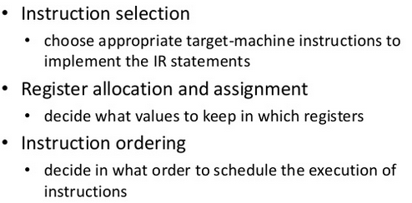
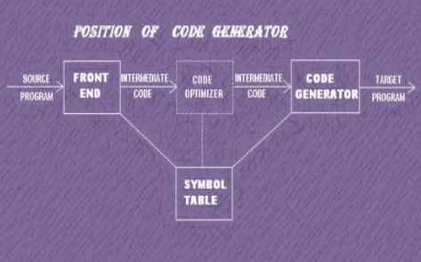
Tasks & position

Slide 4
Issues in the Design of Code generator
Input to the code generator
Target program
Instruction selection
Register allocation
Evaluation order

Slide 5
Design Issue: Input to code generator
IR code + Symbol table information
IR choices:
three address representations such as quadruples, triples, indirect triples
Virtual machine representation such as bytecodes & stack machine code
Linear representation such as postfix notation
Graphical representation such as syntax tree/DAG
Assume that front end has scanned, parsed & translated the source program into low level IR such that names can be directly manipulated by target machine.
Assume that all static semantic errors are detected, type checking done & inserted type conversion operators

Slide 6
Design Issue: Target Program
Target program is an executable m/c language program
Instruction set architecture of the target machine has significant impact on the difficulty of design of code generator
Common target m/c architectures : RISC, CISC & Stack based.
A RISC machine typically has many registers, three-address instructions, simple addressing modes, and a relatively simple instruction-set architecture.
In contrast, a CISC machine typically has a few registers, two-address instructions, a variety of addressing modes, several register classes, variable-length instructions, and instructions with side effects.
In a stack-based machine, operations are done by pushing operands onto a stack and then performing the operations on the operands at the top of the stack. Highly limiting & lot of operations.

Slide 7
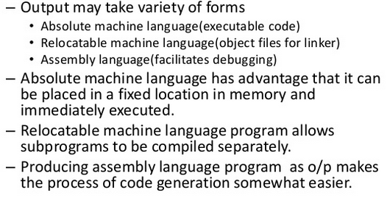
Target program (issue contd..)
Notes:
Relocatable code: advtg.Flexibility; disadvtg. Separate linking & loading functions needed.
Assembly lang. o/p: needs to do assembly after code generation.

Slide 8
Issues: Instruction Selection
Complexity of mapping IR to target code is determined by:
the level of the IR: high level leads to poor code; low level leads to efficient code
the nature of the instruction-set architecture, ex.floating point operations are done using separate registers.
the desired quality of the generated code: speed & size. Redundant load/store, inefficient code (not using INC for increment) affect the efficiency.

Slide 9
Instruction selection issue illustrated
every three-address statement of the form x = y + z, where x, y, and z are statically allocated, can be translated into the code sequence
LD R0, y // R0 = y (load y into register R0)
ADD R0, R0, z // R0 = R0+ z (add z t o R0)
ST x, R0 // x = R0 (store R0 into x)
But, a=b+c; d=a+e get translated into a sequence with redundant store in 4th statement
LD R0, b // R0 = b
ADD R0, R0, c // R0 = R0+c
ST a, R0 // a = R0
LD R0, a // R0 = a
ADD R0, R0, e // R0 = R0+e
ST d, R0 // d = R0
Instruction a=a+1 can be implemented with 1 instruction INC a , rather than by a more obvious sequence that loads a into a register, adds one to the register, and then stores the result back into a.
LD R0, a // R0 = a
ADD R0, R0, #1 // R0 = R0 + 1
ST a, R0 // a = R0

Slide 10
Issues: Register Allocation
Since registers are the fastest memory in the computer, the ideal solution is to store all values in registers. However, there are normally not nearly enough registers for this to be possible. So we must choose which values are in the registers at any given time. Efficient utilization of registers is important.
Actually this problem has two parts.
Which values should be stored in registers? Register allocation
Which register should each selected value be stored in? Register assignment
Finding optimal assignment of registers to variables is difficult & NP complete.
Adhering to register usage convention as required by HW/OS is challenging.

Slide 11
Register allocation Issue Example
Strategies to reduce the number of registers must be made
Certain machines need register pairs (even & next odd numbered register) for say multiplication /division.
Multiply x,y has multiplicand x in even register and y in odd register. The product is in both even&odd registers.
Divide x,y has dividend in even/odd register pair with even register as x. After division the even register (ex.R0) holds the remainder & the odd register (ex.R1) the quotient.

Slide 12
Issues (register allocation ex. Contd..)
Mpld./dvdnd/rmndr mplr/divisor/quotient
Ro R1
Use of Register pair : R0 & R1
M/C Instructions: L: Load, ST: Store, A: Add, M: Multiply, D: Divide, SRDA: Shift Right Double Arithmetic
Three address Code 1 t = a+b t = t*c t = t / d | Three address Code 2 t = a+b t = t+c // addition again t = t/d
Optimal M/c Code sequence for code 1 L R1, a A R1, b M R0, c // product is in both R0&R1 D R0, d // dividend is in R0 (even reg.) ST R1, t // quotient is R1, stored into // memory location t | Optimal M/c Code sequence for code 2 L R0, a A R0, b A R0, c // next, shift dividend into R1 & clear R0 , // so that it gets filled with sign bits SRDA R0, 32 // R1 gets the dividend D R0, d ST R1, t

Slide 13
Design Issues: Evaluation order
The order in which computations are performed can affect can affect the efficiency of the target code.
Certain computation orders require fewer registers to keep fewer intermediate results than others.
Picking a best order is a difficult NP compete problem.
Easiest way is to use the order in which they are produced by the IR generator.

Slide 14
A Simple Target Machine Model (just for ref.)
Our target computer models a three-address machine with load and store operations, computation operations, jump operations, and conditional jumps. The underlying computer is a byte-addressable machine with n general-purpose registers, R0,R1,... ,Rn - 1.
Instructions have: operator, a target, and a list of source operands. Samples:
Load operations: Instruction LD dst, addr loads the value in location addr into location dst (denotes dst = addr ) Ex: LD r, x which loads the value in location x into register r. Instr. LD r1,r2 is a register-to-register copy in which the contents of register r2 are copied into register r1.
• Store operations: The instruction ST x, r stores the value in register r into the location x. This instruction denotes the assignment x = r.
• Computation operations : OP dst, src1,src2, where OP is a operator like ADD or SUB, and dst, src1, and src2 are locations, not necessarily distinct. The effect of this machine instruction is to apply the operation represented by OP to the values in locations src1 and src2, and place the result in location dst. For example, SUB r1,r2,r3 computes r1 = r2 - r3. Any value formerly stored in r1 is lost, but if r1 is
r2 or r3, the old value is read first. Unary operators that take only one operand do not have a src2
• Unconditional jumps: The instruction BR L causes control to branch to the machine instruction with label L. (BR means branch.).
• Conditional jumps of the form Bcond r, L, where r is a register, L is a label, and cond stands for any of the common tests on values in the register r. For example, BLTZ r, L causes a jump to label L if the value in register r is less than zero, and allows control to pass to the next machine instruction if not.
Notes:
Addressing mode: indexed address of the form a(r), integer indexed by a register. For example,
LD Rl, 100(R2), two indirect addressing modes, immediate constant addressing mode

Slide 15

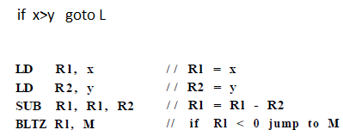

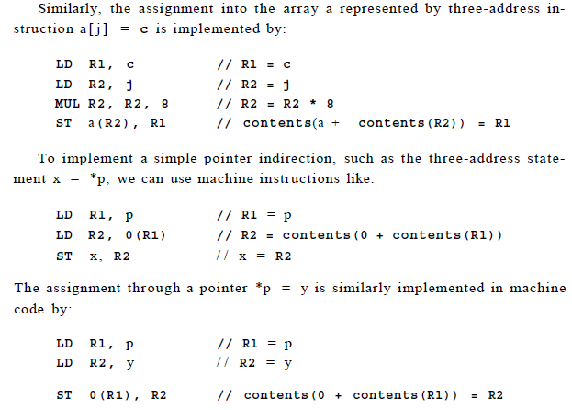
Conversion to Machine instruction examples
x = y – z
b=a[i]

Slide 16
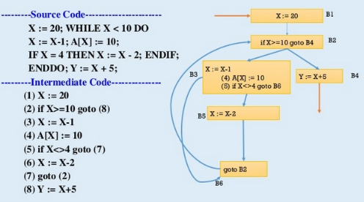
Basic blocks and flow graphs

Slide 17
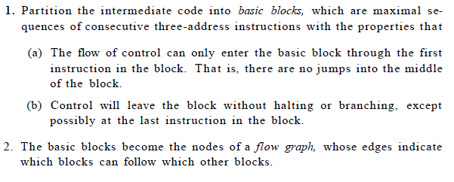
Basic blocks & flow graphs: the representation

Slide 18
Basic blocks
Our first job is to partition a sequence of three-address instructions into basic blocks.
We begin a new basic block with the first instruction and keep adding instructions until we meet either a jump, a conditional jump, or a label on the following instruction.
In the absence of jumps and labels, control proceeds sequentially from one instruction to the next.

Slide 19
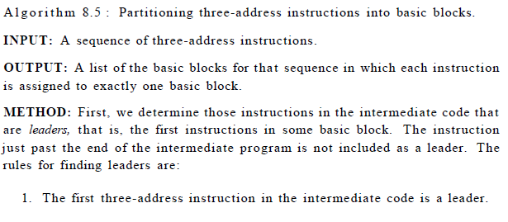
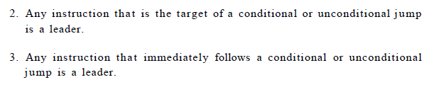
Basic block : Algorithm

Slide 20
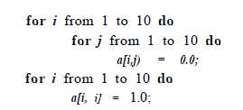
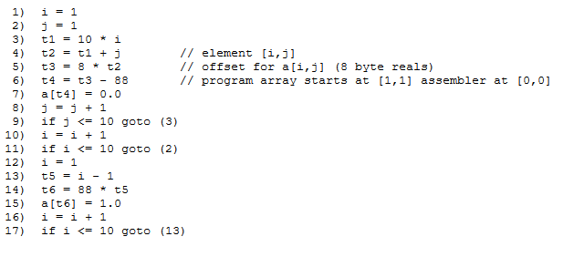
Basic block : example
Given Source code (pseudocode, assume real-valued array elements take 8 bytes each)
Intermediate code to set a 10 x 10 matrix to an identity matrix (row major)
//Note: Leaders are instructions 1, 2, 3, 10, 12, and 13

Slide 21
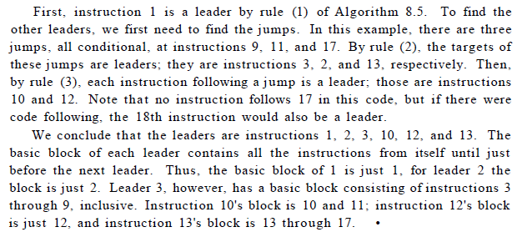
Basic block : method of determining

Slide 22
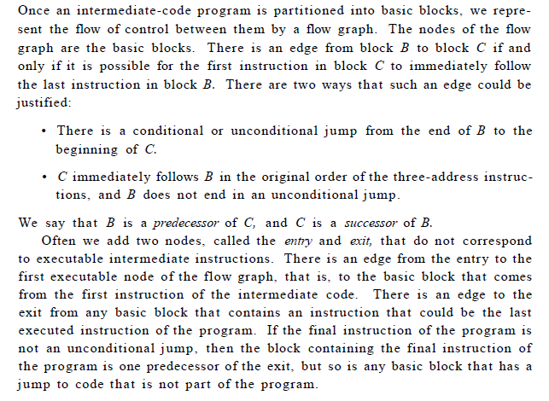
Flow Graph

Slide 23
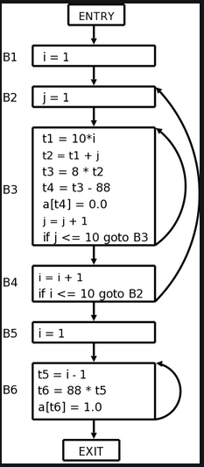
Flow graph Example
The entry points to basic block B1, since B1 contains the first instruction of the program. The only successor of B1 is B2, because B1 does not end in an unconditional jump, and the leader of B2 immediately follows the end of B1.
Block B3 has two successors. One is itself, because the leader of B3, instruction 3, is the target of the conditional jump at the end of B3, instruction 9. The other successor is B4, because control can fall through the conditional jump at the end of B3 and next enter the leader of B4.
Only B6 points to the exit of the flow graph, since the only way to get to code that follows the program from which we constructed the flow graph is to fall through the conditional jump that ends B6.

Slide 24
Representation of flow graphs
Flow graphs, being quite ordinary graphs, can be represented by any of the data structures appropriate for graphs. The content of nodes (basic blocks) need their own representation. We might represent the content of a node by a pointer to the leader in the array of three-address instructions, together with a count of the number of instructions or a second pointer to the last instruction.
However, since we may be changing the number of instructions in a basic block frequently, it is likely to be more efficient to create a linked list of instructions for each basic block.

Slide 25
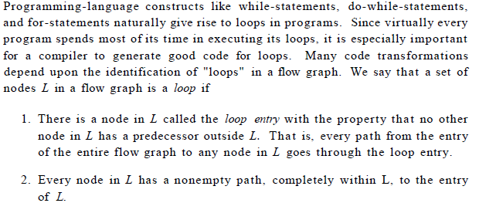
Loops
The program example has 3 loops: 1) B3 itself, 2) B6 itself and
3) L={B2, B3, B4} B2 has predecessor B1 not in L.
B2 has path B2->B3-> B4-> B2

Slide 26
Optimization of the basic blocks

